Slide 1

Applications of GIS
Week 9
Assignment 4: Disaster management in GIS Introduction, some demonstrations

Slide 2
Today’s Tutorial
How did assignment 3 go?
Some demonstrations for assignment 4

Slide 3
Assignment 4 Quick Recap
The State government for an Australian state has contracted you to perform a risk analysis for a natural disaster of either floods or bushfires.
Need to find out where is it at most risk of a bushfire or flood.
Need to make a model of the real world with various constraints, that represents this risk

Slide 4
Do the assignment in 5 easy step!
Do literature review, the information learned from reading other people’s literature will form a strong foundation of how you will conduct your analysis and which areas you will focus on for your report. More important than previous assignments
Key search terms: Multi-criteria analysis, risk analysis, GIS risk analysis, spatial analysis in natural disasters, risk mapping
Look for which risk factors were used in analysis, what data did they use, how did they do it? How could you replicate this in ArcGIS pro.
Get some data, from the literature review what environmental/ community/ risk factors were used in other people’s analysis. Start downloading data from sources, data.vic.gov.au, AURIN, etc.
Make Hazard raster layers, using tools from workflow and literature review start doing analysis and making raster layers that represent a natural disaster hazard, these will then be combined to calculate total hazard then risk. Main thing you need to do is create a score from the raw data values to a relative score of 1-10 for each raster.
Make layers for elements at risk and vulnerability, what are the community/ environmental/ industrial elements at risk and how are they more vulnerable? Combine these layers with hazard layers to get risk for each element at risk.
Write report, literature review should be mostly written, write method and then focus on discussion combine how your results compared to other peoples, what are the main take away from analysis, recommendations to the government. Conclusion, make sure to include limitations and future analysis.

Slide 5
Floods

Slide 6
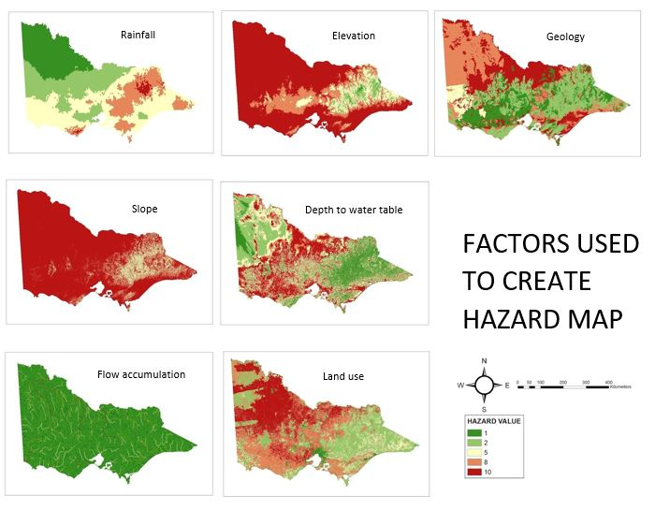
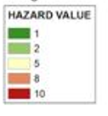
Process
Download data
What data will you need for your hazard maps? What is a flood Hazard? What data will you need to make maps from?
E.g. DEM (Slope, flow accumulation)
Rainfall
Land use
Geology etc.
Reclassify data
Reclassify based on Hazard for your chosen disaster
You cannot create a hazard map without the same legend
1-10 scale or similar recommended
Reclassify based off values or literature (Recommended to read page 221 of flood article 2 on LMS)

Slide 7
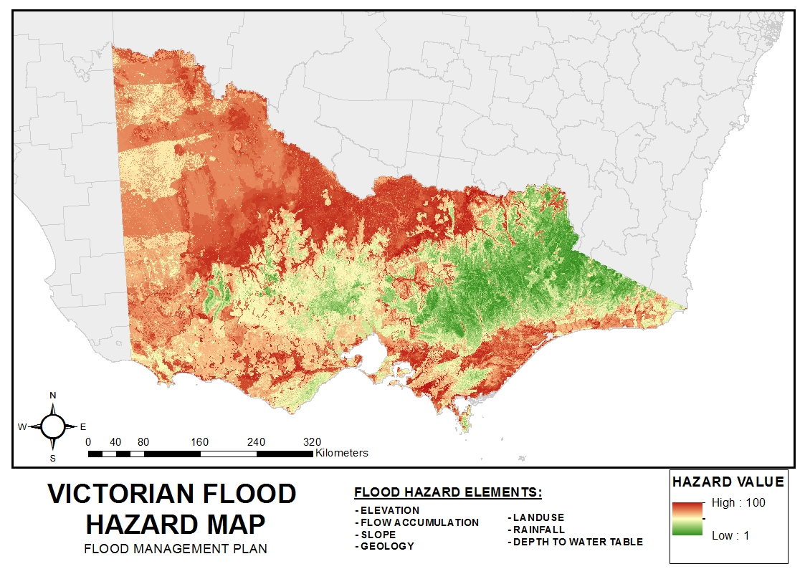
Process
3. Use raster calculator to add maps and create a Hazard map
Use weighting if required (Based off literature)
Weight certain hazards more than others when calculating if they effect your disaster more than other hazards
4. Repeat the same process with vulnerability data
Who is most vulnerable?
Can do this based off population, environment, industry and infrastructure
5. Add infrastructure data to analyse the effect of your disaster with environment, population, industry and infrastructure

Slide 8
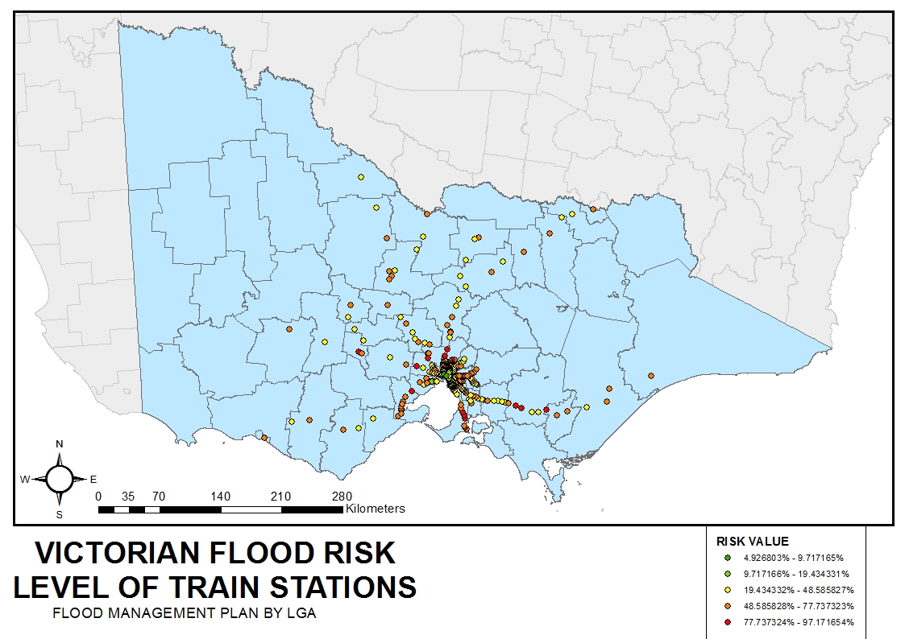
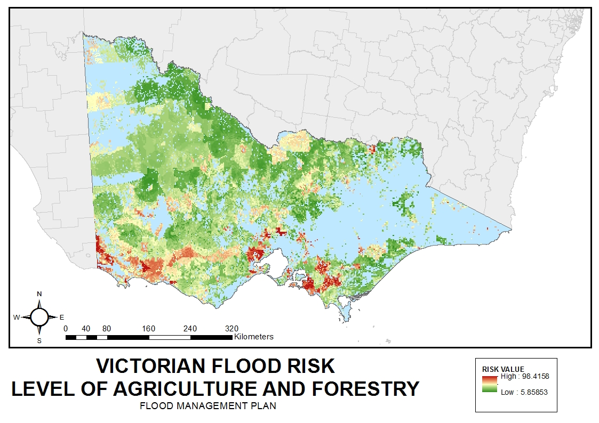
Example maps: Floods

Slide 9
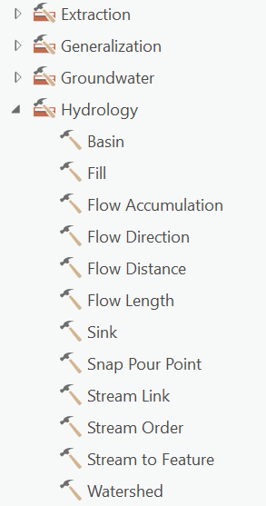
Useful tools for flood maps
Adding rainfall data (or other BOM data):
http://www.bom.gov.au/climate/data-services/maps.shtml
Data is in an ASCII format. To fix this and map your data:
Table to Table tool – export data into geodatabase
Define projection to WGS84
ASCII to Raster tool
Project raster to MGA or the coordinate system that you are using
2. Flow accumulation
Flow direction tool (not raster function)
Flow accumulation tool
3. Toolbox
There are many tools in the hydrology toolbox for flood modelling and more in other toolboxes

Slide 10
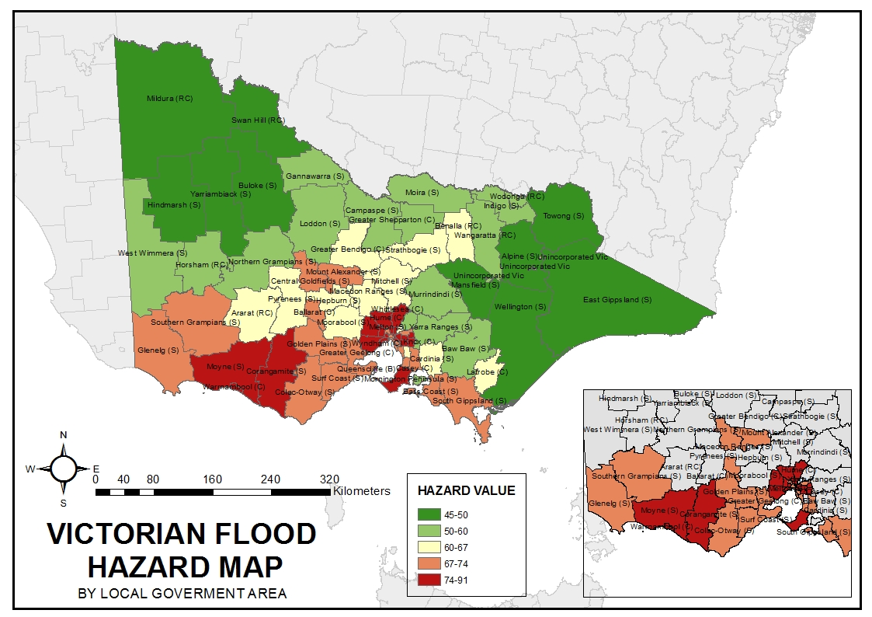
Example maps: Floods
4. Zonal statistics tool
Uses the mean raster cell value (e.g. for a hazard map) and assigns a value per region (SA2 or LGA)
This is useful for analysis in focusing on providing recommendations for those regions most at risk and their infrastructure, environmental factors etc.

Slide 11
Other useful tools
4. Polygon to Raster – such as tree density, population density (no. of people per land area)
5. Euclidean distance to locations – such as roads, fire brigades and hospitals
6. Clip the data above with your Hazard maps to create risk maps for certain industries etc.

Slide 12
Bushfires

Slide 13
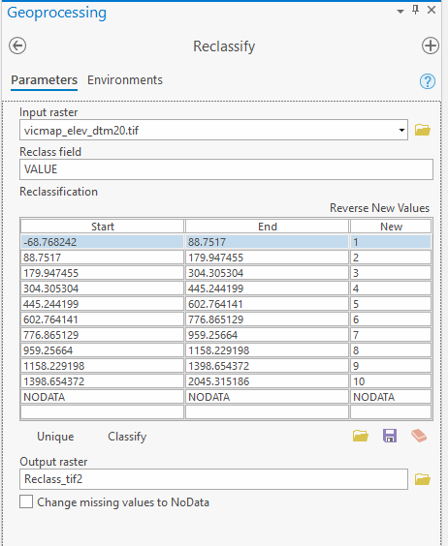
Reclassifying
The thing in the assignment you really need to think about!!
Need to have good reasoning and research to base your reclassification on
Changing the rasters values from RAW numbers to a Relative Risk Scale
Lets reclassify slope
TRINITY, S. 1997. Bushfire Hazard Mapping. Analysis of bushfire susceptibility based on vegetation type and slope. Cairns.
Slope % | Hazard Value
0 - 3 | 20
3 – 10 | 40
10 – 20 | 60
20 – 30 | 80
30 + | 100

Slide 14
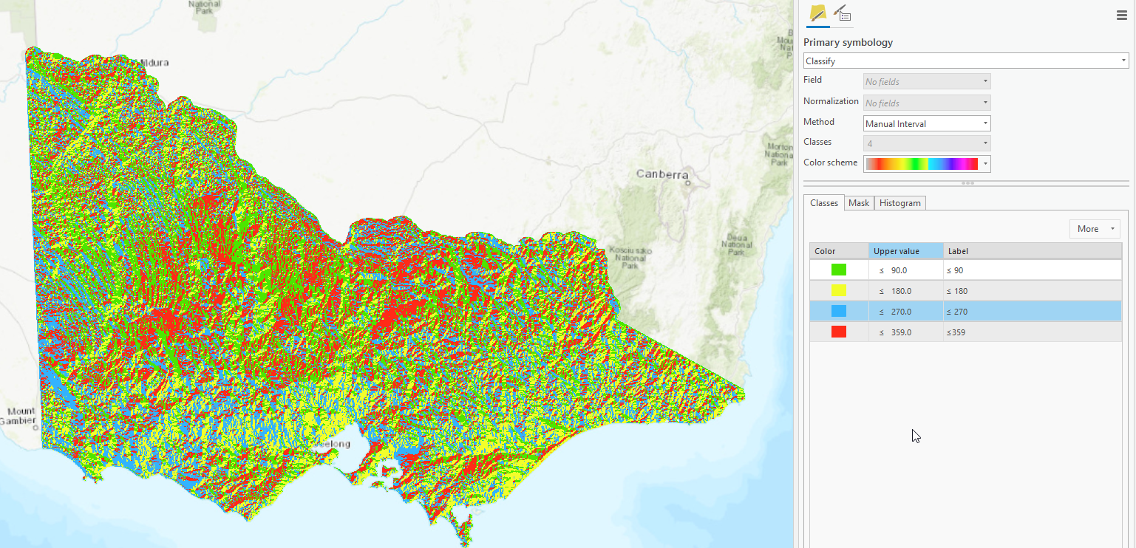
Aspect
Which direction does the terrain face?
North, South, East, West?
How does this increase fire risk?
How would you reclassify?

Slide 15
Polygon to Raster
Euclidian Distance Tool
Example past fires.
Polygon layer converted into raster with season date as Value. The Reclassify Tool was then used to give hazard values according to when the area was last burnt. According to the table below.
Computes the straight line distance from data to everywhere else.
From:
Fire brigades
Roads
Electricity Lines
Season Burnt | Hazard Value
1903 – 1968 | 100
1968 – 1993 | 80
1993 – 2013 | 10

